Slide 1


Lecture 1-2
DLI
The Norm of a Vector
向量的模

Slide 2
DLI
Review
Points in Space 空间中的点；
Located Vectors in Space 空间中的向量；
Scalar Product 数量积；

Slide 3
DLI
Outline
Norm of a vector 向量的模；
The Distance between A and B 两点间距离；
General Pythagoras theorem 毕达哥拉斯定理；
Schwarz Inequality 施瓦茨不等式.

Slide 4
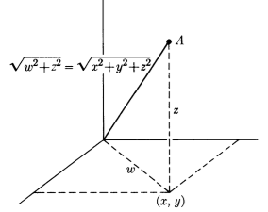
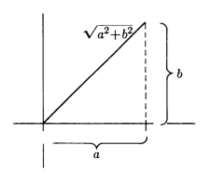
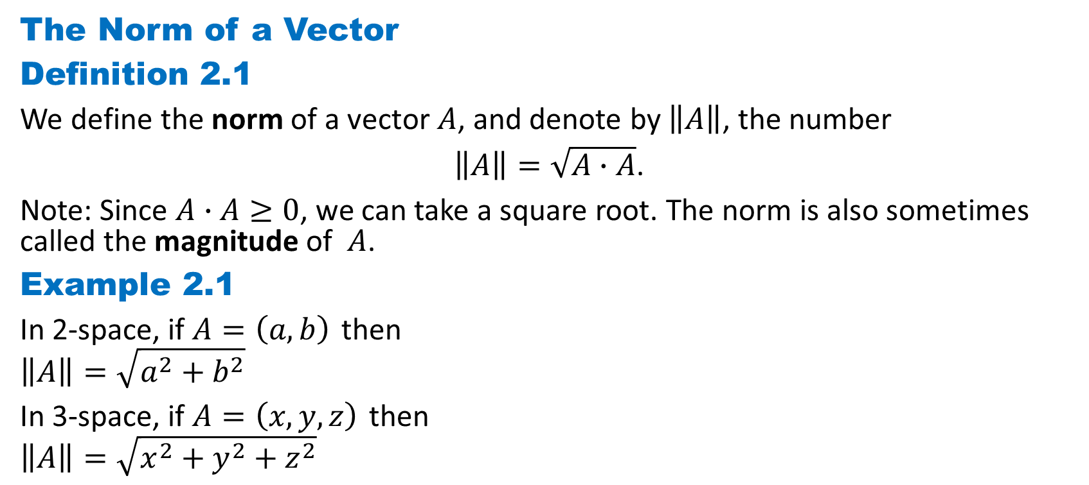
DLI
The Norm of a Vector
Definition 2.1
We define the norm of a vector $A$, and denote by $\left\|A\right\|$, the number
$\left\|A\right\|=\sqrt{A∙A}$.
Note: Since $A∙A≥0$, we can take a square root. The norm is also sometimes called the magnitude of $A$.
Example 2.1
In 2-space, if $A=\left(a, b\right)$ then
$$\left\|A\right\|=\sqrt{a^{2}+b^{2}}$$
In 3-space, if $A=\left(x, y,z\right)$ then
$$\left\|A\right\|=\sqrt{x^{2}+y^{2}+z^{2}}$$

Slide 5
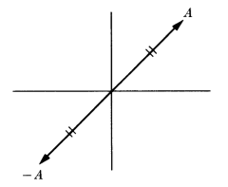
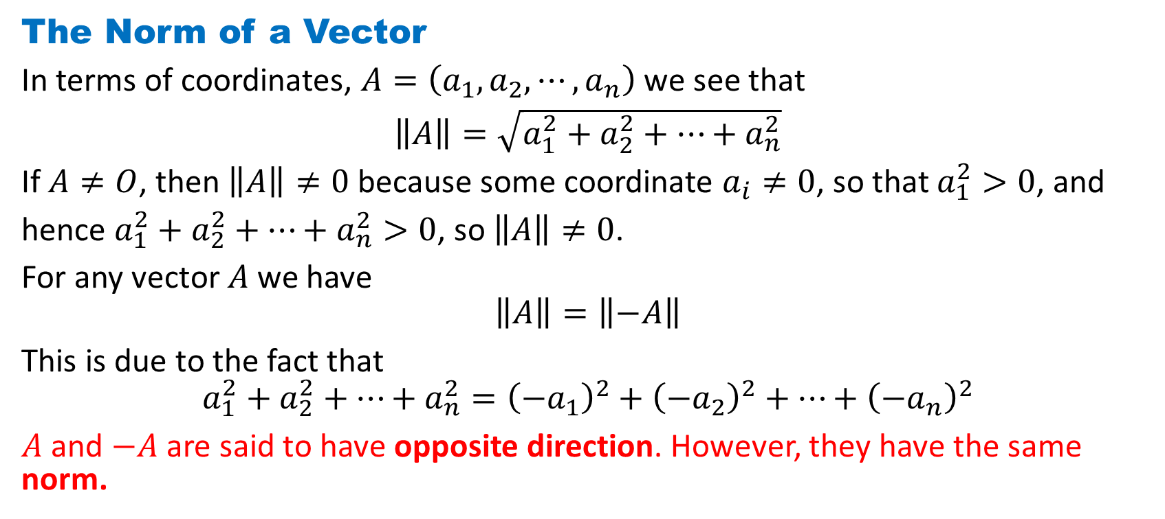
DLI
The Norm of a Vector
In terms of coordinates, $A=\left(a_{1},a_{2}, ⋯,a_{n}\right)$ we see that
$\left\|A\right\|=\sqrt{a_{1}^{2}+a_{2}^{2}+⋯+a_{n}^{2}}$
If $A≠O$, then $\left\|A\right\|≠0$ because some coordinate $a_{i}≠0$, so that $a_{1}^{2}>0$, and
hence $a_{1}^{2}+a_{2}^{2}+⋯+a_{n}^{2}>0$, so $\left\|A\right\|≠0$.
For any vector $A$ we have
$$\left\|A\right\|=\left\|−A\right\|$$
This is due to the fact that
$$a_{1}^{2}+a_{2}^{2}+⋯+a_{n}^{2}={\left(−a_{1}\right)}^{2}+{\left(−a_{2}\right)}^{2}+⋯+{\left(−a_{n}\right)}^{2}$$
$A$ and $−A$are said to have opposite direction. However, they have the same norm.

Slide 6
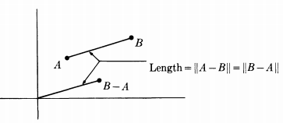
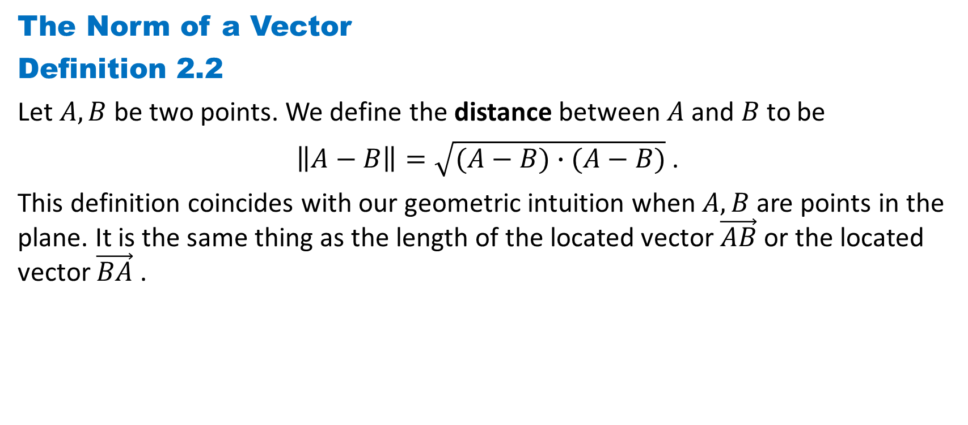
DLI
The Norm of a Vector
Definition 2.2
Let $A,B$ be two points. We define the distance between $A$ and $B$ to be
$\left\|A−B\right\|=\sqrt{(A−B)∙(A−B)}$ .
This definition coincides with our geometric intuition when $A,B$ are points in the plane. It is the same thing as the length of the located vector $\vec{AB}$ or the located vector $\vec{BA}$ .

Slide 7
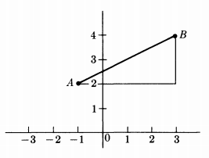
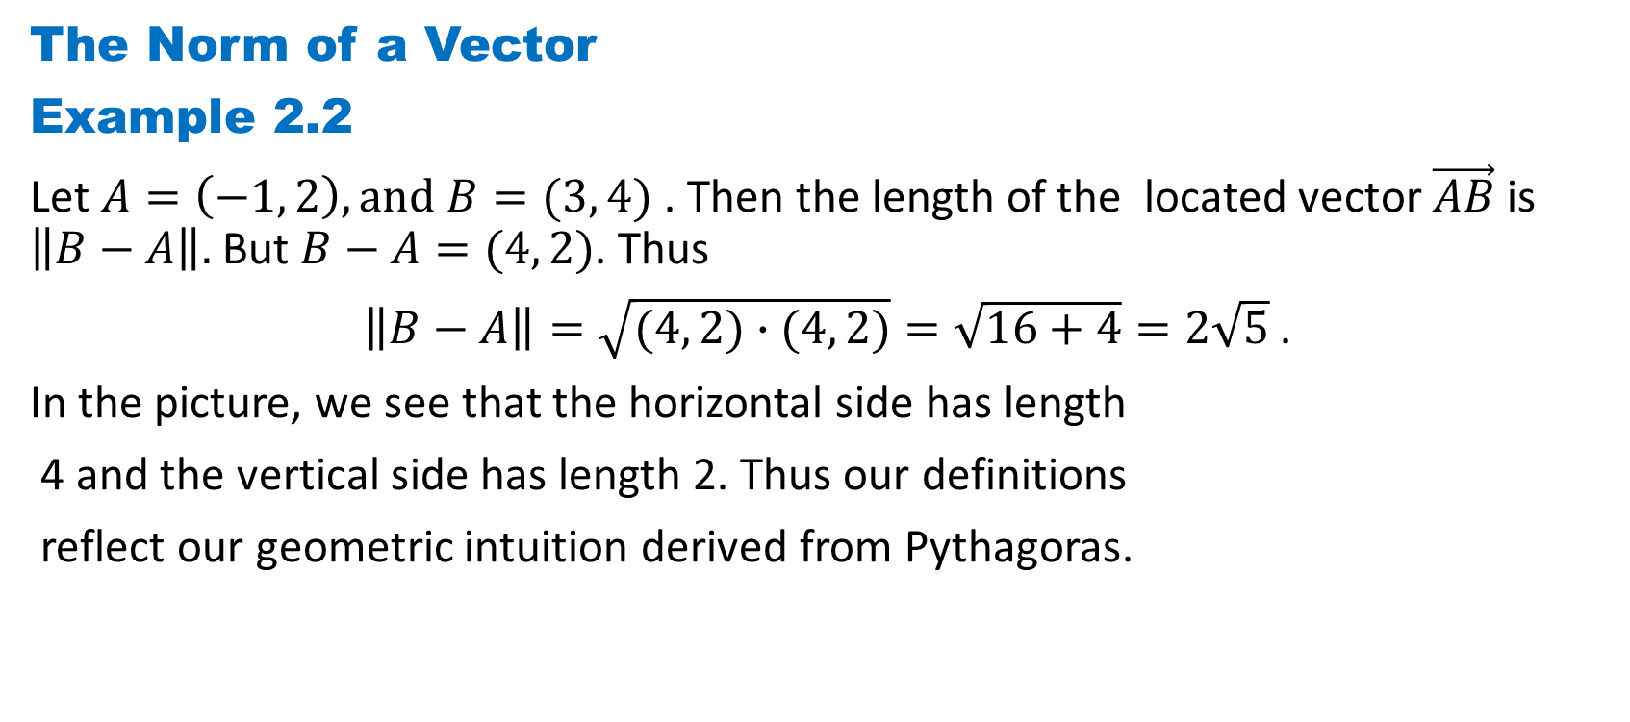
DLI
The Norm of a Vector
Example 2.2
Let $A=\left(−1, 2\right),and B=(3, 4)$ . Then the length of the located vector $\vec{AB}$ is $\left\|B−A\right\|.$ But $B−A=(4, 2)$. Thus
$\left\|B−A\right\|=\sqrt{(4, 2)∙(4, 2)}=\sqrt{16+4}=2\sqrt{5}$ .
In the picture, we see that the horizontal side has length
4 and the vertical side has length 2. Thus our definitions
reflect our geometric intuition derived from Pythagoras.

Slide 8
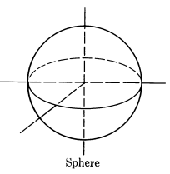
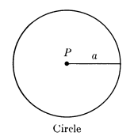
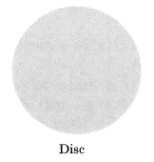
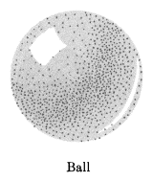
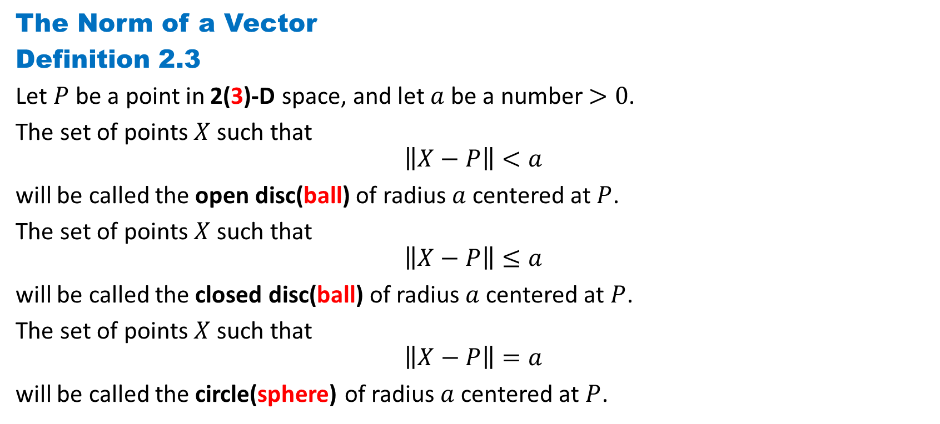
DLI
The Norm of a Vector
Definition 2.3
Let $P$ be a point in 2(3)-D space, and let $a$ be a number $>0$.
The set of points $X$ such that
$$\left\|X−P\right\|<a$$
will be called the open disc(ball) of radius $a$ centered at $P$.
The set of points $X$ such that
$$\left\|X−P\right\|≤a$$
will be called the closed disc(ball) of radius $a$ centered at $P$.
The set of points $X$ such that
$$\left\|X−P\right\|=a$$
will be called the circle(sphere) of radius $a$ centered at $P$.

Slide 9
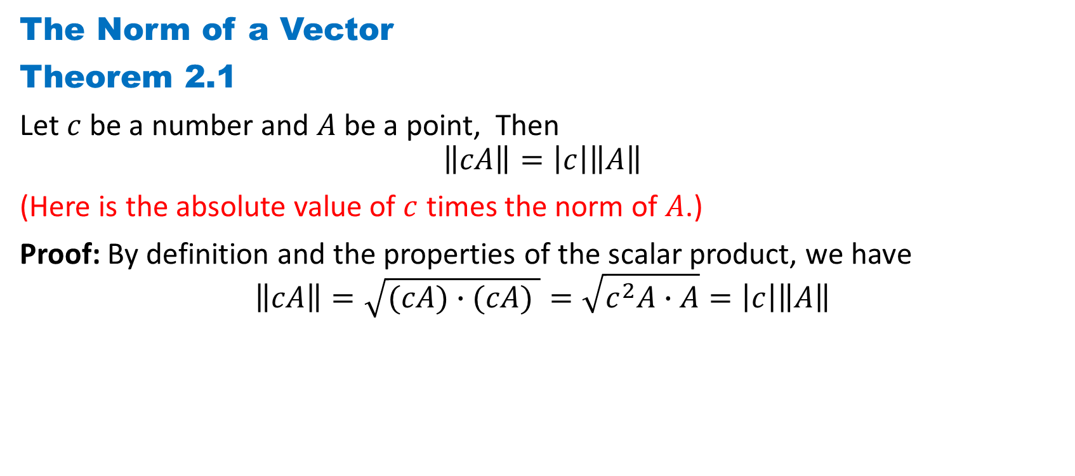
DLI
The Norm of a Vector
Theorem 2.1
Let $c$ be a number and $A$ be a point, Then
$$\left\|cA\right\|=\left|c\right|\left\|A\right\|$$
(Here is the absolute value of $c$ times the norm of $A$.)
Proof: By definition and the properties of the scalar product, we have
$$\left\|cA\right\|=\sqrt{(cA)∙(cA) }=\sqrt{c^{2}A∙A}=\left|c\right|\left\|A\right\|$$

Slide 10
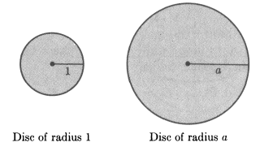
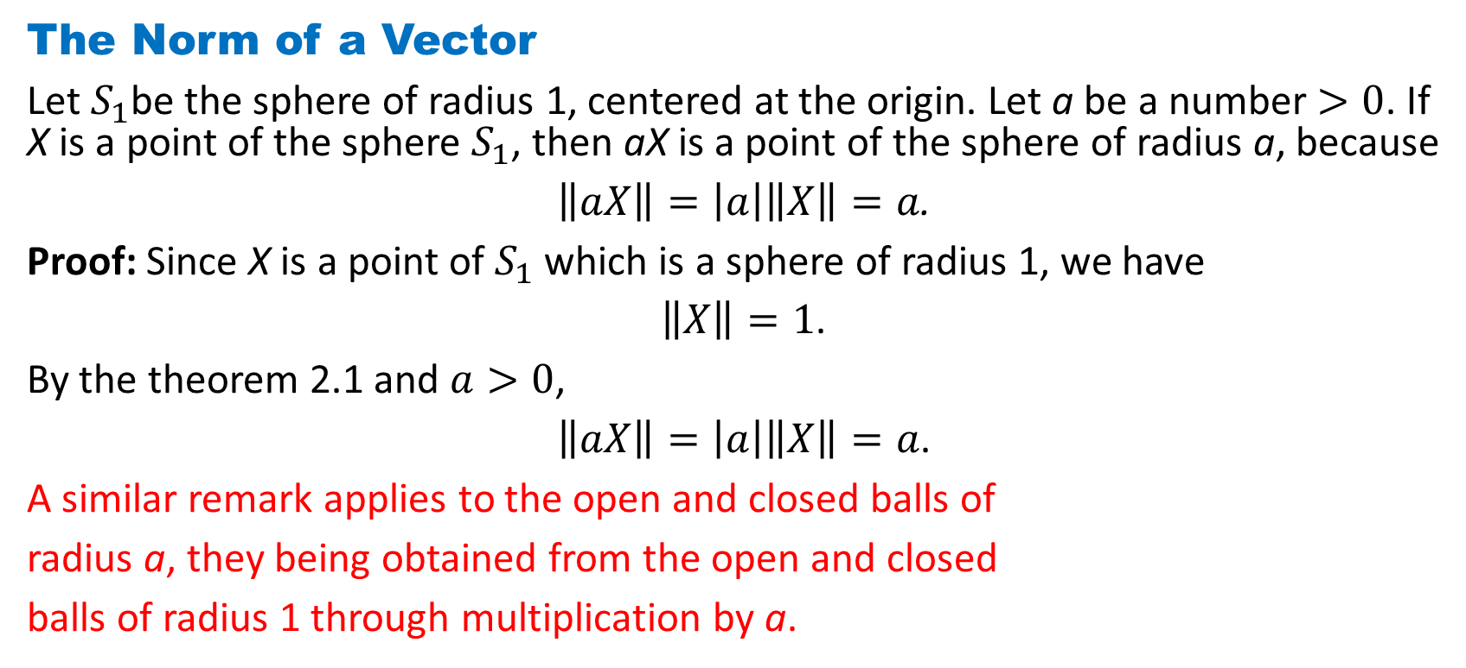
DLI
The Norm of a Vector
Let $S_{1}$be the sphere of radius 1, centered at the origin. Let a be a number $>0$. If X is a point of the sphere $S_{1}$, then aX is a point of the sphere of radius a, because
$\left\|aX\right\|=\left|a\right|\left\|X\right\|=a$.
Proof: Since X is a point of $S_{1}$which is a sphere of radius 1, we have
$\left\|X\right\|=1$.
By the theorem 2.1 and $a>0$,
$\left\|aX\right\|=\left|a\right|\left\|X\right\|=a$.
A similar remark applies to the open and closed balls of
radius a, they being obtained from the open and closed
balls of radius 1 through multiplication by a.

Slide 11
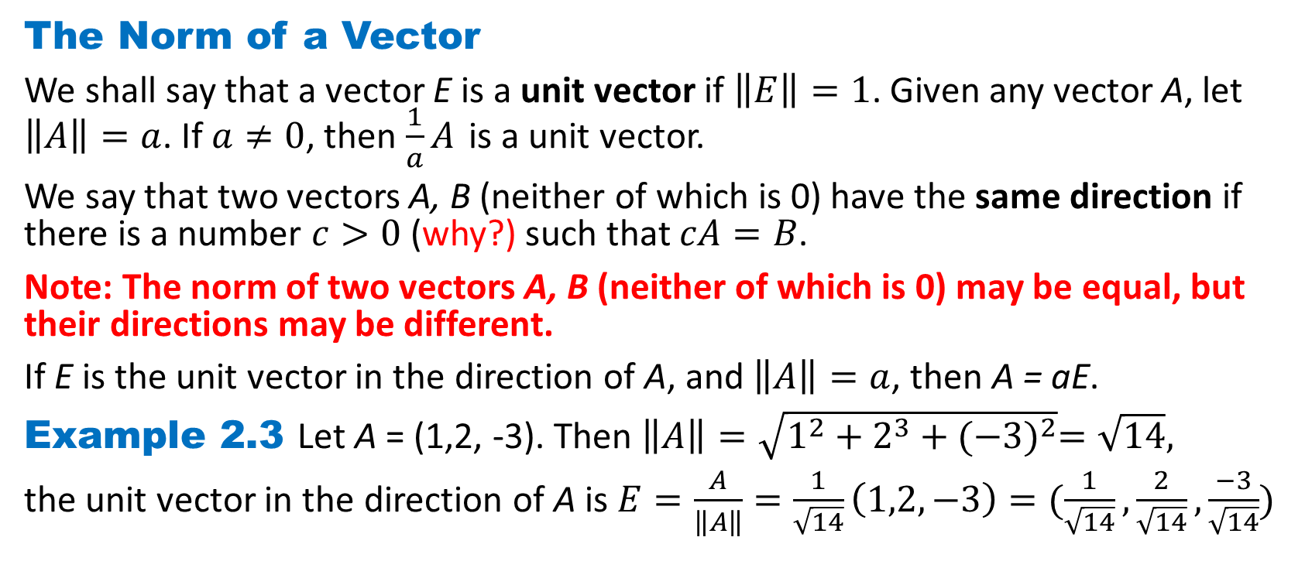
DLI
The Norm of a Vector
We shall say that a vector E is a unit vector if $\left\|E\right\|=1$. Given any vector A, let $\left\|A\right\|=a$. If $a≠0$, then $\frac{1}{a}A$ is a unit vector.
We say that two vectors A, B (neither of which is 0) have the same direction if there is a number $c>0$ (why?) such that $cA=B$.
Note: The norm of two vectors A, B (neither of which is 0) may be equal, but their directions may be different.
If E is the unit vector in the direction of A, and $\left\|A\right\|=a$, then A = aE.
Example 2.3 Let A = (1,2, -3). Then $\left\|A\right\|=\sqrt{1^{2}+2^{3}+{(−3)}^{2}}=\sqrt{14},$
the unit vector in the direction of A is $E=\frac{A}{\left\|A\right\|}=\frac{1}{\sqrt{14}}\left(1,2,−3\right)=(\frac{1}{\sqrt{14}},\frac{2}{\sqrt{14}},\frac{−3}{\sqrt{14}})$

Slide 12
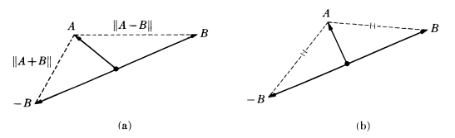
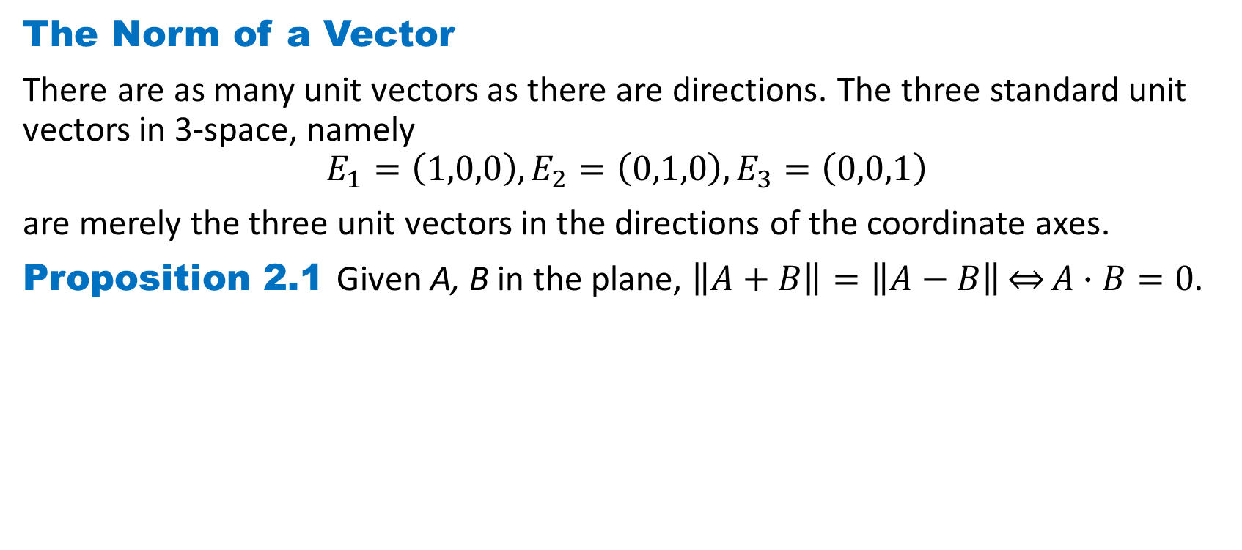
DLI
The Norm of a Vector
There are as many unit vectors as there are directions. The three standard unit vectors in 3-space, namely
$$E_{1}=\left(1,0,0\right),E_{2}=\left(0,1,0\right),E_{3}=\left(0,0,1\right)$$
are merely the three unit vectors in the directions of the coordinate axes.
Proposition 2.1 Given A, B in the plane, $\left\|A+B\right\|=\left\|A−B\right\|\overset{⇔}{}A∙B=0$.

Slide 13
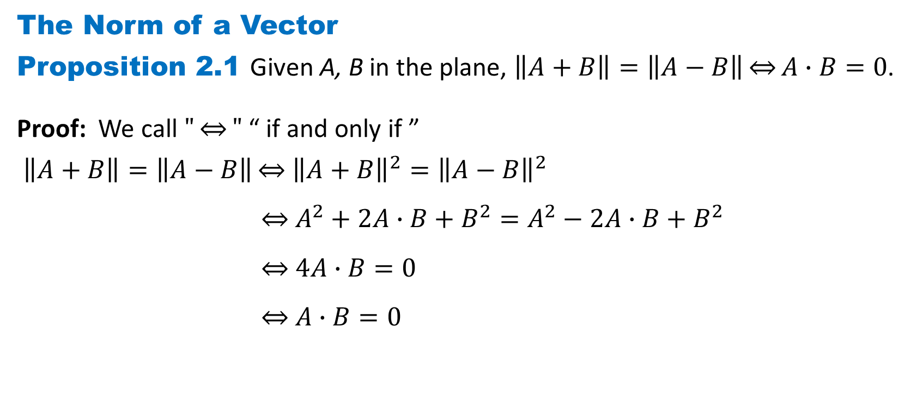
DLI
The Norm of a Vector
Proposition 2.1 Given A, B in the plane, $\left\|A+B\right\|=\left\|A−B\right\|\overset{⇔}{}A∙B=0$.
Proof: We call $"\underset{⇔}{}"$ “ if and only if ”
$\left\|A+B\right\|=\left\|A−B\right\|\overset{⇔}{}$ ${\left\|A+B\right\|}^{2}={\left\|A−B\right\|}^{2}$
$A^{2}+2A∙B+B^{2}=A^{2}−2A∙B+B^{2}$
$4A∙B=0$
$A∙B=0$

Slide 14
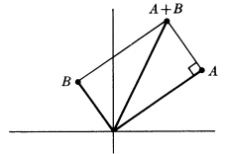
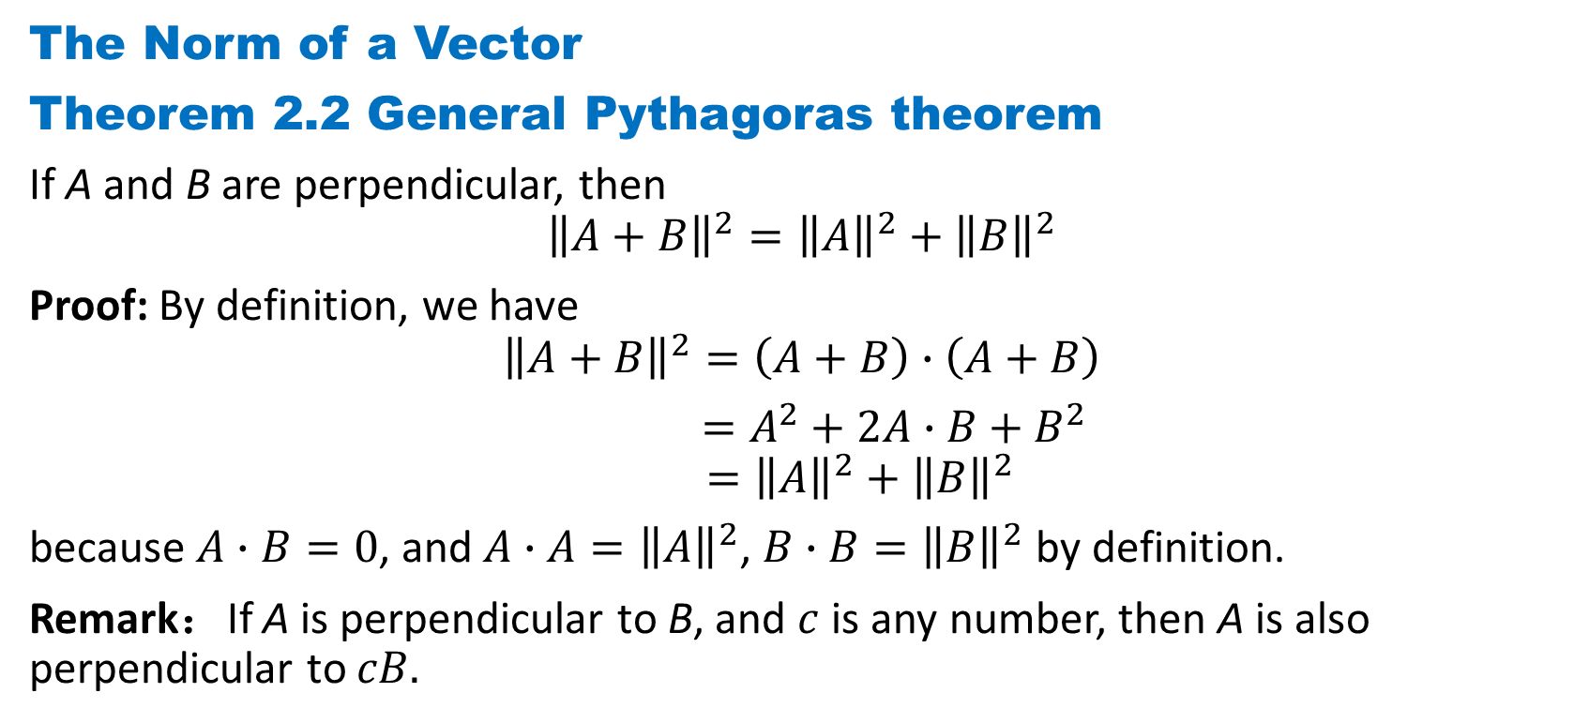
DLI
The Norm of a Vector
Theorem 2.2 General Pythagoras theorem
If A and B are perpendicular, then
$${\left\|A+B\right\|}^{2}={\left\|A\right\|}^{2}+{\left\|B\right\|}^{2}$$
Proof: By definition, we have
$${\left\|A+B\right\|}^{2}=\left(A+B\right)∙\left(A+B\right)$$
$=A^{2}+2A∙B+B^{2}$ $={\left\|A\right\|}^{2}+{\left\|B\right\|}^{2}$
because $A∙B=0$, and $A∙A={\left\|A\right\|}^{2}$, $B∙B={\left\|B\right\|}^{2}$by definition.
Remark：If A is perpendicular to B, and $c$ is any number, then A is also perpendicular to $cB.$

Slide 15
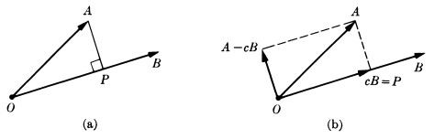
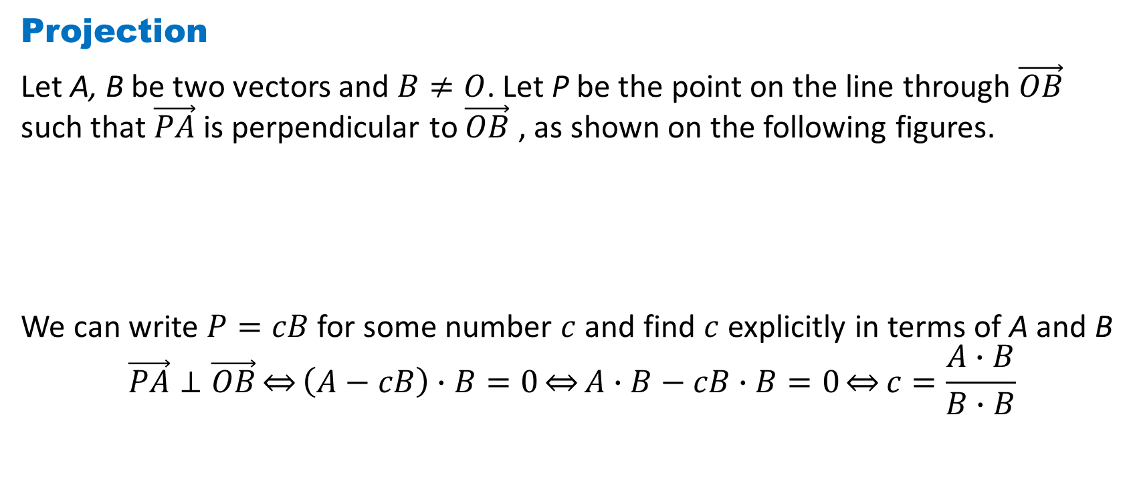
DLI
Projection
Let A, B be two vectors and $B≠O$. Let P be the point on the line through $\vec{OB}$ such that $\vec{PA}$ is perpendicular to $\vec{OB}$ , as shown on the following figures.
We can write $P=cB$ for some number $c$ and find $c$ explicitly in terms of A and B
$$\vec{PA}⊥\vec{OB}\overset{⇔}{}\left(A−cB\right)∙B=0\overset{⇔}{}A∙B−cB∙B=0\overset{⇔}{}c=\frac{A∙B}{B∙B}$$

Slide 16
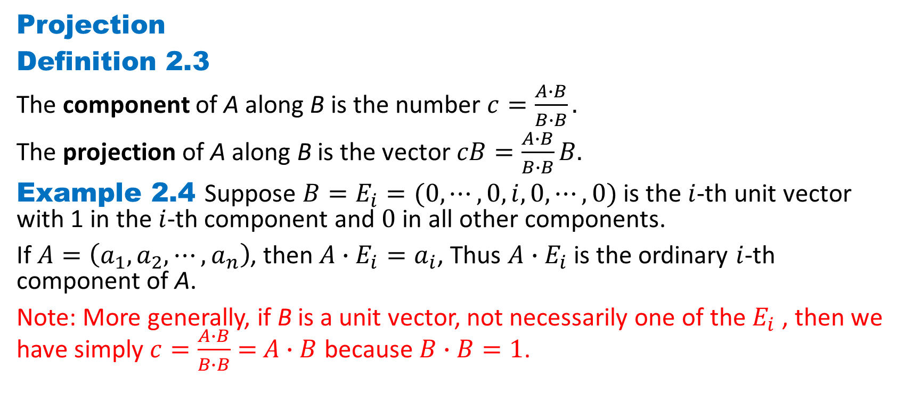
DLI
Projection
Definition 2.3
The component of A along B is the number $c=\frac{A∙B}{B∙B}.$
The projection of A along B is the vector $cB=\frac{A∙B}{B∙B}B.$
Example 2.4 Suppose $B=E_{i}=(0,⋯,0,i,0,⋯,0)$ is the $i$-th unit vector with 1 in the $i$-th component and $0$ in all other components.
If $A=\left(a_{1},a_{2},⋯,a_{n}\right)$, then ${A∙E}_{i}=a_{i}$, Thus ${A∙E}_{i}$ is the ordinary $i$-th component of A.
Note: More generally, if B is a unit vector, not necessarily one of the $E_{i}$ , then we have simply $c=\frac{A∙B}{B∙B}=$ $A∙B$ because $B∙B=1$.

Slide 17
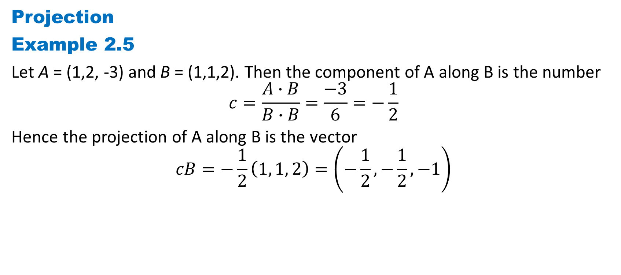
DLI
Projection
Example 2.5
Let A = (1,2, -3) and B = (1,1,2). Then the component of A along B is the number
$$c=\frac{A∙B}{B∙B}=\frac{−3}{6}=−\frac{1}{2}$$
Hence the projection of A along B is the vector
$$cB=−\frac{1}{2}\left(1, 1, 2\right)=\left(−\frac{1}{2},−\frac{1}{2}, −1\right)$$

Slide 18
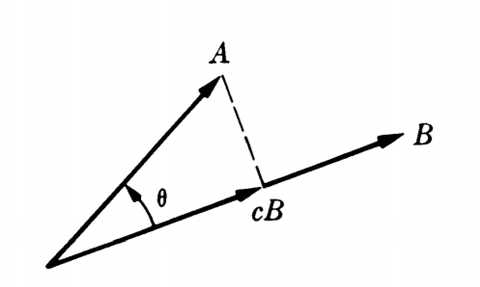
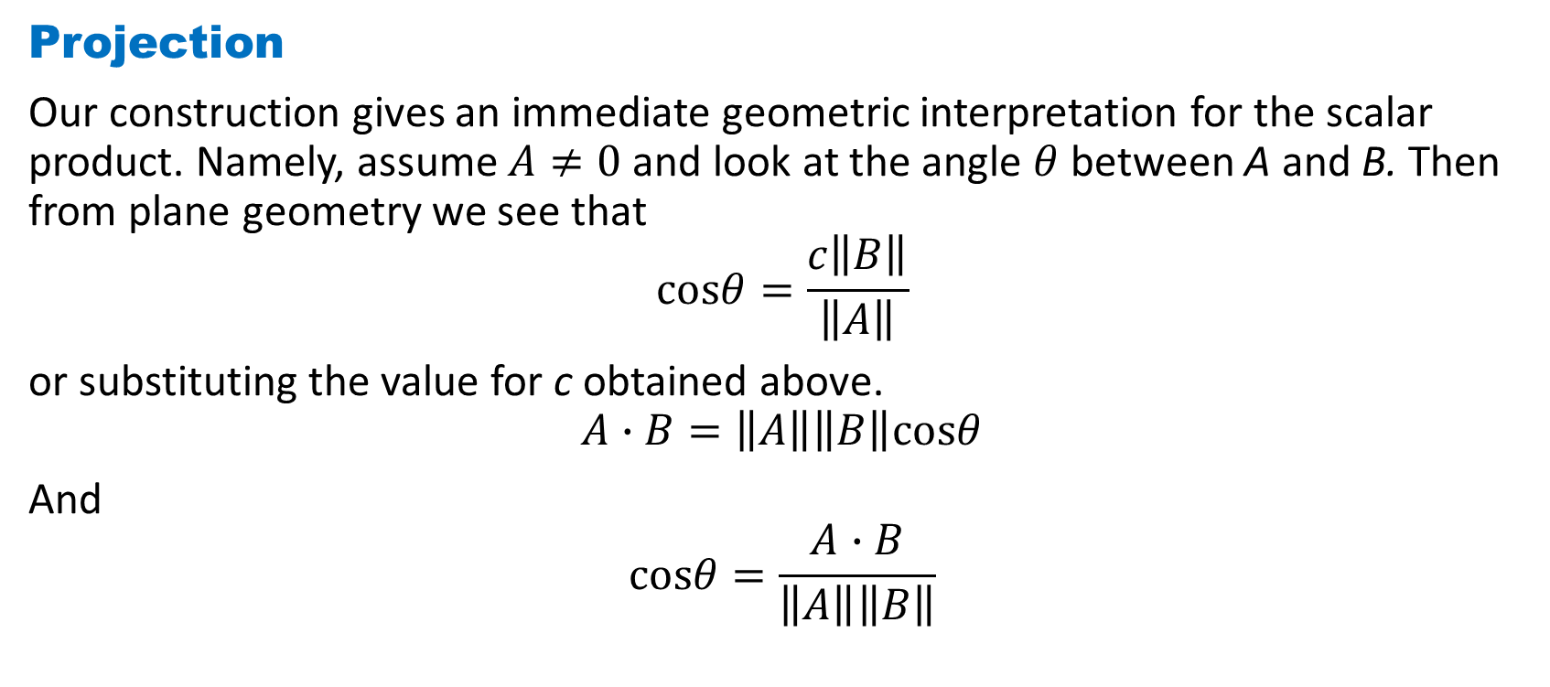
DLI
Projection
Our construction gives an immediate geometric interpretation for the scalar product. Namely, assume $A≠0$ and look at the angle $θ$ between A and B. Then from plane geometry we see that
$$cosθ=\frac{c\left\|B\right\|}{\left\|A\right\|}$$
or substituting the value for c obtained above.
$$A∙B=\left\|A\right\|\left\|B\right\|cosθ$$
And
$$cosθ=\frac{A∙B}{\left\|A\right\|\left\|B\right\|}$$

Slide 19
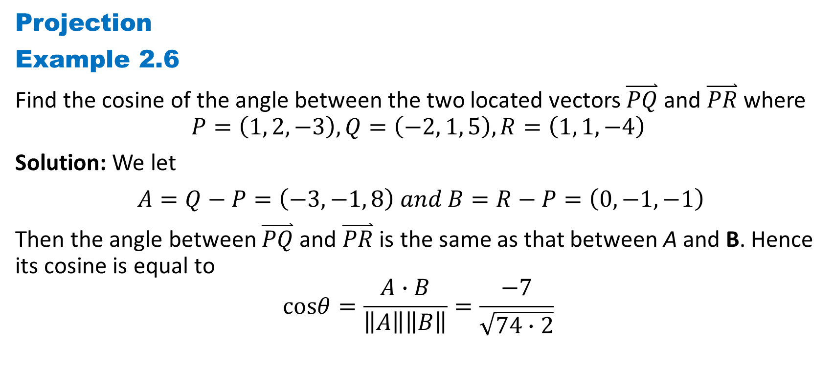
DLI
Projection
Example 2.6
Find the cosine of the angle between the two located vectors $\overset{⃑}{PQ}$ and $\overset{⃑}{PR}$ where
$$P=\left(1, 2, −3\right),Q=\left(−2, 1, 5\right),R=\left(1, 1, −4\right)$$
Solution: We let
$A=Q−P=\left(−3, −1, 8\right) and B=R−P=\left(0, −1, −1\right)$
Then the angle between $\overset{⃑}{PQ}$ and $\overset{⃑}{PR}$ is the same as that between A and B. Hence its cosine is equal to
$$cosθ=\frac{A∙B}{\left\|A\right\|\left\|B\right\|}=\frac{−7}{\sqrt{74∙2}}$$

Slide 20
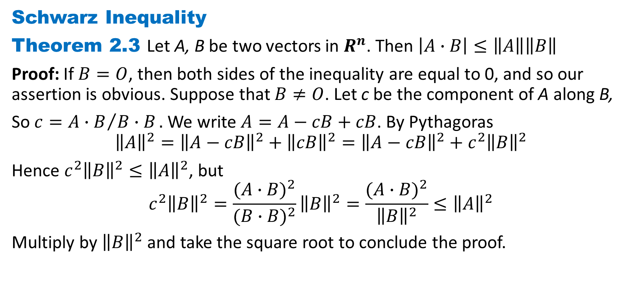
DLI
Schwarz Inequality
Theorem 2.3 Let A, B be two vectors in $R^{n}$. Then $\left|A∙B\right|≤\left\|A\right\|\left\|B\right\|$
Proof: If $B=O$, then both sides of the inequality are equal to 0, and so our assertion is obvious. Suppose that $B≠O$. Let c be the component of A along B,
So $c={A∙B}/{B∙B}.$ We write $A=A−cB+cB$. By Pythagoras
$${\left\|A\right\|}^{2}={\left\|A−cB\right\|}^{2}+{\left\|cB\right\|}^{2}={\left\|A−cB\right\|}^{2}+{c^{2}\left\|B\right\|}^{2}$$
Hence ${c^{2}\left\|B\right\|}^{2}≤{\left\|A\right\|}^{2}$, but
$${c^{2}\left\|B\right\|}^{2}=\frac{{(A∙B)}^{2}}{{(B∙B)}^{2}}{\left\|B\right\|}^{2}=\frac{{(A∙B)}^{2}}{{\left\|B\right\|}^{2}}≤{\left\|A\right\|}^{2}$$
Multiply by ${\left\|B\right\|}^{2}$and take the square root to conclude the proof.

Slide 21
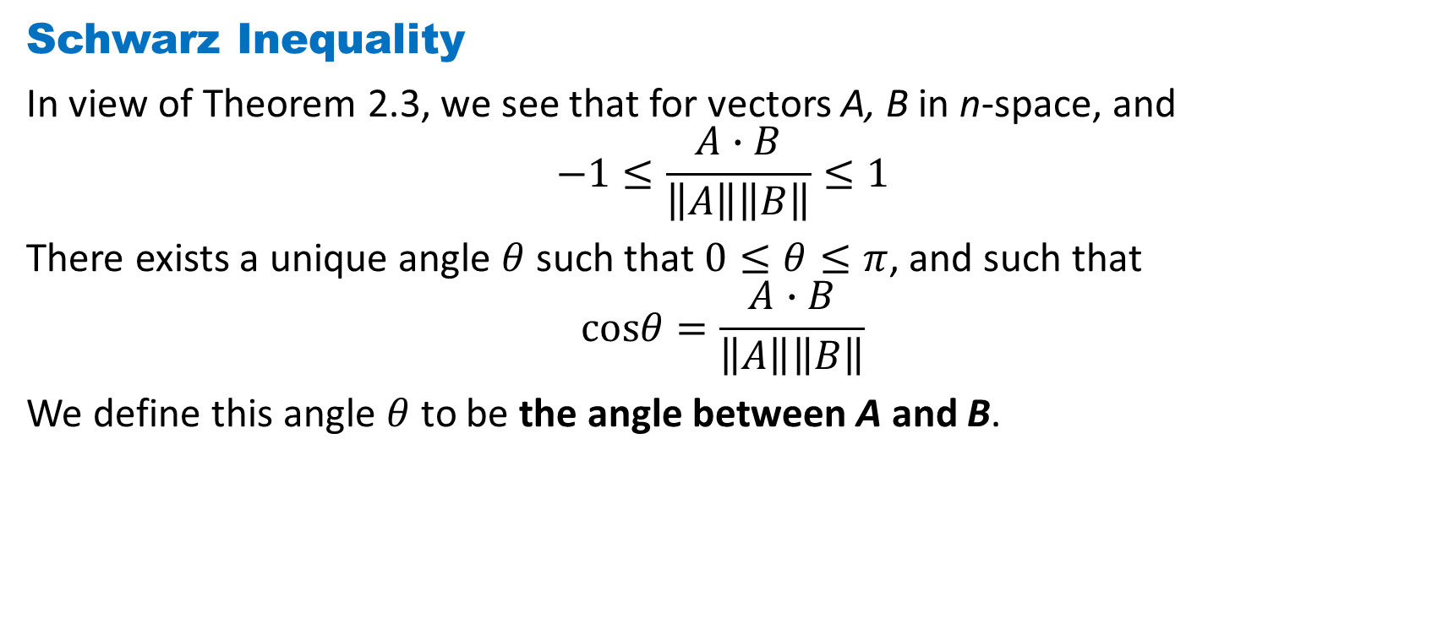
DLI
Schwarz Inequality
In view of Theorem 2.3, we see that for vectors A, B in n-space, and
$$−1≤\frac{A∙B}{\left\|A\right\|\left\|B\right\|}≤1$$
There exists a unique angle $θ$ such that $0≤θ≤π$, and such that
$$cosθ=\frac{A∙B}{\left\|A\right\|\left\|B\right\|}$$
We define this angle $θ$ to be the angle between A and B.

Slide 22
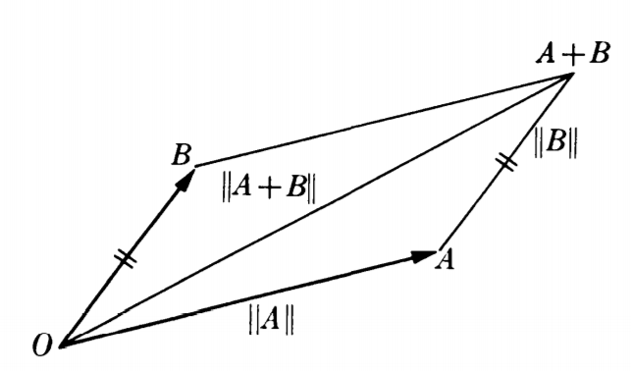

DLI
Triangle Inequality
Theorem 2.4 Let A, B be two vectors. Then $\left\|A+B\right\|≤\left\|A\right\|+\left\|B\right\|.$
Proof: Both sides of this inequality are positive or 0. Hence it will suffice to prove that their squares satisfy the desired inequality, in other words,
$$(A+B)∙(A+B) ≤{\left(\left\|A\right\|+\left\|B\right\|\right)}^{2}$$
Here
$\left(A+B\right)∙\left(A+B\right)=$ $A∙A+2A∙B+A∙B$ $$≤{\left\|A\right\|}^{2}+2\left\|A\right\|\left\|B\right\|+{\left\|B\right\|}^{2}$$
$={\left(\left\|A\right\|+\left\|B\right\|\right)}^{2}$
Our theorem is proved.

Slide 23
DLI
Homework 1-2
Exercise 1.4 Page 29
Q1、2、3、4(c,d), Q6(a), Q7, Q8(a), Q9, Q10

